Slide 1

Manual Testing
- Kalyani Pakhale

Slide 2
Software Testing?
Software testing is the process of evaluating a system to check if it satisfies its business requirements. It measures the overall quality of the system in terms of attributes. Like – correctness, completeness, usability, performance, etc. Basically, it is used for ensuring the quality of software to the stakeholders of the application.

Slide 3


Slide 4


Slide 5
Why is testing required?
We need software testing for the following reasons- 1. Testing provides an assurance to the stakeholders that the product works as intended. 2. Avoidable defects leaked to the end-user/customer without proper testing adds a bad reputation to the development company. 3. Defects detected earlier phase of SDLC results in lesser cost and resource utilization of correction. 4. Saves development time by detecting issues in an earlier phase of development. 5. The testing team adds another dimension to the software development by providing a different viewpoint to the product development process.

Slide 6
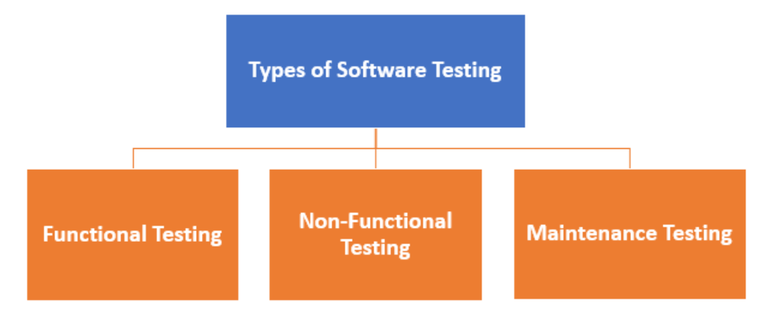
Types of Software Testing
Functional Testing
Non-Functional Testing or Performance Testing
Maintenance (Regression and Maintenance)

Slide 7
Testing Category | Types of Testing
Functional Testing | Unit Testing Integration Testing Smoke UAT ( User Acceptance Testing) Localization Globalization Interoperability So on

Slide 8
Non-Functional Testing | Performance Endurance Load Volume Scalability Usability So on

Slide 9
Maintenance | Regression Maintenance

Slide 10
Testing Strategies in Software Engineering
Unit Testing: This software testing basic approach is followed by the programmer to test the unit of the program. It helps developers to know whether the individual unit of the code is working properly or not.
Integration testing: It focuses on the construction and design of the software. You need to see that the integrated units are working without errors or not.

Slide 11
Summary of Software Testing Basics:
Define Software Testing: Software testing is defined as an activity to check whether the actual results match the expected results and to ensure that the software system is Defect free.
Testing is important because software bugs could be expensive or even dangerous.
The important reasons for using software testing are: cost-effective, security, product quality, and customer satisfaction.
Typically Testing is classified into three categories functional testing, non-functional testing or performance testing, and maintenance.
The important strategies in software engineering are: unit testing, integration testing, validation testing, and system testing.

Slide 12
System testing: In this method, your software is compiled as a whole and then tested as a whole. This testing strategy checks the functionality, security, portability, amongst others.

Slide 13
Who does Testing?
Testing is/can be done by all technical and non-technical people associated with the software. Testing in its various phases is done by-
Developer – Developer does the unit testing of the software and ensures that the individual methods work correctly.
Tester – Testers are the face of software testing. A tester verifies the functionality of the application as a functional tester, checks the performance of the application as a Performance tester, automates the functional test cases and creates test scripts as an automation tester.
Test Managers/Lead/Architects – Develop and define the test strategy and test plan documents.
End users – A group of end-users do the User Acceptance Testing (UAT) of the application to make sure the software can work in the real world.

Slide 14
How is Software Testing done?
Testing can be done both manually as well as using automation tools. When performed manually, it is called Manual Testing. It includes requirements verification, development of test strategy and plan; test case preparation, test case execution, defect creation, defect retesting, and finally test report sharing with all the relevant stakeholders. When automated tools are used, it is called Automation testing. It includes test script preparation and test report generation using different tools like – Selenium, Katalon Studio, QTP, etc.

Slide 15
When do we start Software Testing?
Development Phase | Testing Activity
Requirement Design | Acceptance test creation
Functional Specification | Functional test case creation
Implementation | Unit test case creation
Code Complete | Test case execution

Slide 16
When to stop testing?
Sufficient pass percentage – Depending on the system, testing can be stopped when an agreed-upon test case pass percentage is reached.
After a successful test case execution – The testing phase can be stopped when one complete cycle of test cases is executed after the last known bug fix.
On meeting deadline – Testing can be stopped after deadlines get met with no high priority issues left in the system.
Mean Time Between Failure (MTBF)– MTBF is the time interval between two inherent failures. Based on the different stakeholder’s decisions, if the MTBF is quite large, one can stop the testing.

Slide 17


Slide 18
What is Software Quality?
Software quality is the conformance of a software system to its requirements. In the software perspective, quality is defined by two factors – Validation and Verfication Validation checks if the process used during software development is correct or not. Whereas, in verification, the product is evaluated to check if it meets the business requirements. We will deal with both verification and validation in detail, in our next post. For now, let’s move to the different attributes of Software Quality.

Slide 19
Attributes of Software Quality
Correctness – Correctness measures the software quality for the conformance of the software to its requirements.
Reliability – Checks if the software performs its functions without any failure within the expected conditions.
Robustness – Robustness is the ability of the software to not crash when provided with unexpected input.
Usability – Usability is the ease of operating the software application.
Completeness – Completeness is the extent to which the software system meets its specifications.
Maintainable – Maintainability is the measure of the amount of effort required for software maintenance after it has shipped to the end-user.
Portability – Ability of the software to be transformed from one platform or infrastructure to others.
Efficiency – Efficiency is the measure of resources required for the functioning of the software.

Slide 20
Quality Assurance Definition
Part of quality management focused on providing confidence that quality requirements will be fulfilled
Basically, Quality Assurance is a set of activities to prevent non-conformance of a system to its requirements. It ensures that the built software product meets all the specified requirements of the customer. Unlike Quality Control(QC), we don’t actually test the software product in QA.

Slide 21
Salient features of Quality Assurance
QA is a static process of analyzing the documents and the process involved in building the product.
It doesn’t involve testing the built product.
In testing “Verification” comes under QA.
It answers the question – “Are we building the product right?”
QA is a preventive measure as it identifies the vulnerability in the process to build software.
It involves activities like document review, test documents review, walk-throughs, audits, inspection, etc.

Slide 22
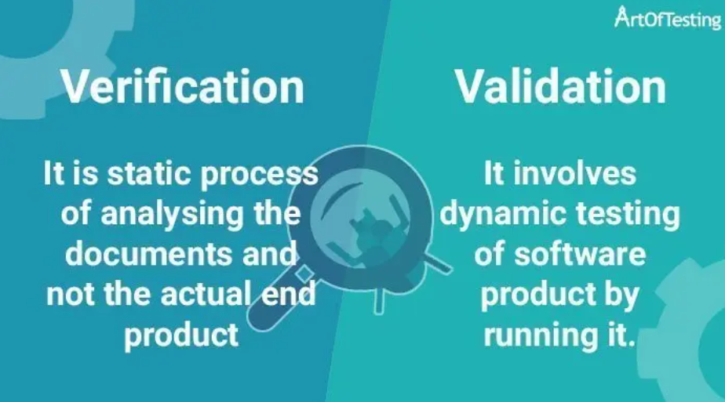

Slide 23
Verification is the process of evaluating the artifacts of software development in order to ensure that the product being developed will comply with the standards. It is the static process of analyzing the documents and not the actual end product. Whereas, Validation is the process of validating that the developed software product conforms to the specified business requirements. It involves dynamic testing of a software product by running it.

Slide 24
Verification | Validation
Verification involves the evaluation of artifacts of software development to ensure that the product being developed will comply with its requirements. | Validation involves validation of developed software product to check if it conforms to the specified business requirements.
It is a static process of analyzing the documents and not the actual end product. | It involves dynamic testing of a software product by running it.
Verification is a process-oriented approach. | Validation is a product-oriented approach.
Answers the question – “Are we building the product, right?” | Answers the question – “Are we building the right product?”
Errors found during verification require lesser cost/resources to get fixed as compared to be found during the validation phase. | Errors found during validation require more cost/resources. Later the error is discovered higher is the cost to fix it.
It involves activities like document review, test cases review, walk-throughs, inspection etc. | It involves activities like functional testing, automation testing etc.

Slide 25
What is SDLC?
SDLC stands for “Software Development Life Cycle”. It describes the various phases involved in the software development process using which we can create and maintain a software application efficiently.
The software development life cycle starts with the requirement gathering phase and after that, based on the requirements are defined and design specifications are created. The high and low-level designs created in the design-specification phase lead to the implementation phase. In the implementation phase, coding is done. This phase leads to a software product that is required to be tested in order to validate its business requirements. After successful testing(product with no high priority bugs), the software is deployed to the client.

Slide 26
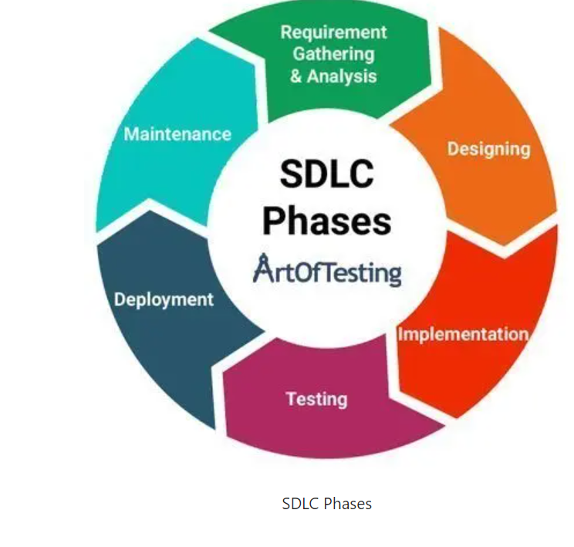
Phases of SDLC

Slide 27
Requirement Gathering & Analysis
Requirement gathering is one of the most critical phases of SDLC. This phase marks the basis of the whole software development process. All the business requirements are gathered from the client in this phase. A formal document is created which defines the purpose of the product and marks the guidelines for the other phases of the life cycle.

Slide 28
Designing
Software design or we can say a layout is prepared in this phase according to the requirements specified in the previous step (requirement gathering). In this phase, the requirements are broken down into multiple modules like login module, signup module, main functionality, etc. This design document is considered as the input for the next implementation phase.

Slide 29
Implementation
In this phase, the actual development gets started. The developer writes code using different languages and platforms, depending on the need of the product. The main stakeholder in this phase is the development team.

Slide 30
Testing
After the completion of the development phase, testing begins. Here testers test the software and provide appropriate feedback to the developing team. The tester checks whether the software developed fulfills the specified requirements as stated in the requirement phase. Both functional and non-functional testing are performed in this phase before the final delivery to the client.

Slide 31
Deployment
After the testing gets completed, the product is handed over to the client. This phase involves making the software product live in the production environment.

Slide 32
Maintenance
In this phase, the maintenance of the software product is taken care of. It involves making changes to the software that are required to make it operational with the change in infrastructure, configuration, etc, over a period of time.

Slide 33

Software Development Life Cycle Models
Depending on the requirement, budget, criticality, and various other factors, we can choose between the various SDLC models. Let’s briefly check some of the most widely used SDLC models.
Waterfall Model
V Model
Spiral Model
Iterative Model
Prototype Model
RAD Model
Agile Methodology

Slide 34
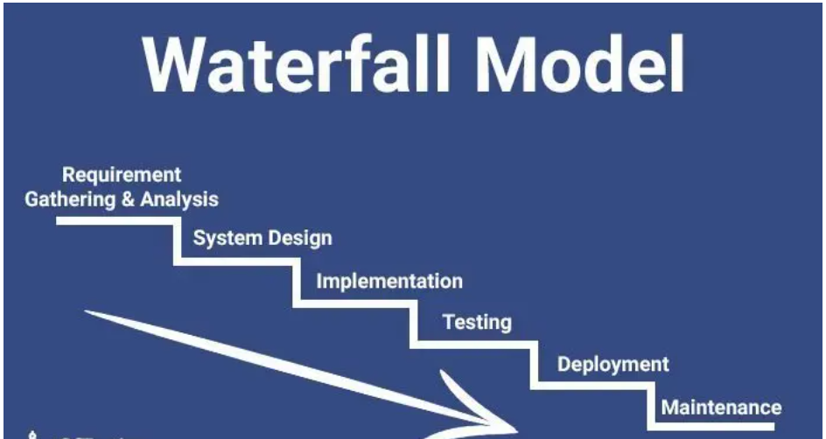
Waterfall Model in Software Engineering

Slide 35
Phases of the Waterfall Model
Requirement Gathering & Analysis
System Design
Implementation
Testing
Deployment
Maintenance

Slide 36
Advantages of the Waterfall Model
It is easy to understand and implement.
There are specific deliverables in each phase of the life cycle.
All the activities to be performed in each phase are clearly defined.
It is perfectly suitable for short projects where all the requirements are predefined and understood clearly.

Slide 37
Disadvantages of Waterfall Model
As this model requires freezing of requirements, hence, it not suitable for projects in which changes in requirements are possible/inevitable.
The working model is only visible in the later phases of the life cycle – after the implementation phase.
Any correction or update in the previous phase is not possible.
It is not possible to keep track of the progress or state of the development within stages.

Slide 38
Application of Waterfall Model
The Waterfall model is applicable for following types of projects-
It is suitable for short term or smaller projects.
Projects where requirements are perfectly documented and clearly understood.
Projects where frequent changes are not required or anticipated.

Slide 39
Spiral Model:
Spiral Model was first described by Barry W. Boehm (American Software Engineer) in 1986.
The spiral model works in an iterative nature. It is a combination of both the Prototype development process and the Linear development process (waterfall model). This model places more emphasis on risk analysis. Mostly this model adapts to large and complicated projects where risk is high. Every Iteration starts with planning and ends with the product evaluation by the client.

Slide 40
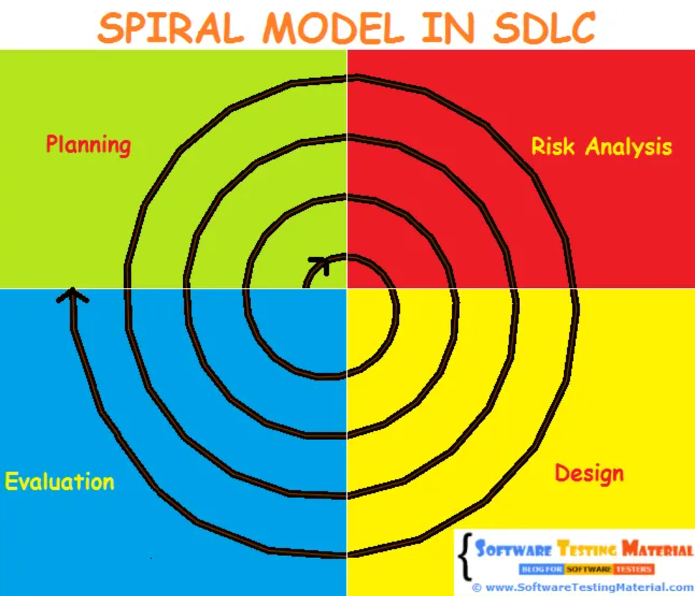

Slide 41
Let’s take an example of a product development team (like Microsoft). They know that there will be high risk and they face lots of difficulties in the journey of developing and releasing the product and also they know that they will release the next version of the product when the current version is in existence. They prefer the Spiral Model to develop the product in an iterative nature. They could release one version of the product to the end-user and start developing the next version which includes new enhancements and improvements on the previous version (based on the issues faced by the user in the previous version). Microsoft released Windows 8 and improved it based on user feedback and released the next version (Windows 8.1).

Slide 42
spiral Model undergoes 4 phases.
Planning Phase – Requirement Gathering, Cost Estimation, Resource Allocation Risk Analysis Phase – Strengths and weaknesses of the project Design Phase – Coding, Internal Testing and deployment Evaluation Phase – Client Evaluation (Client-side Testing) to get the feedback

Slide 43

Advantages:
It allows requirement changes
Suitable for large and complicated projects
It allows better risk analysis
Cost effective due to good risk management
Disadvantages:
Not suitable for small projects
The success of the project depends on the risk analysis phase
Have to hire more experienced resource especially for risk analysis

Slide 44
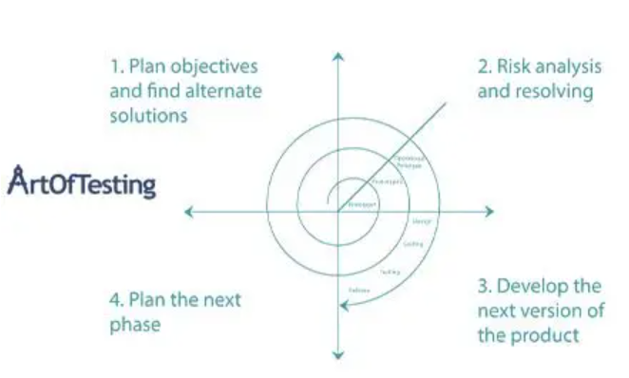

Slide 45
V Model
V model is also known as the Verification and Validation model. In the V model, the testing phase goes in parallel with the development phase. Thus, the testing phase starts right at the beginning of SDLC.

Slide 46
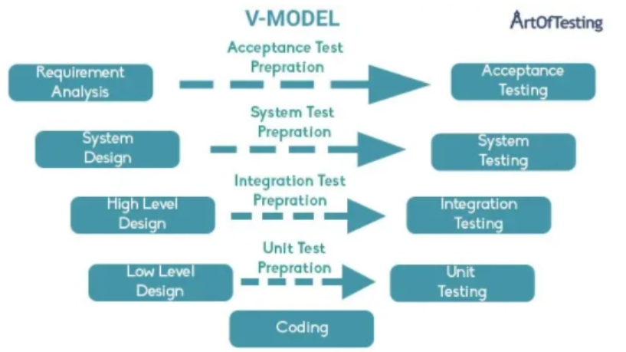

Slide 47
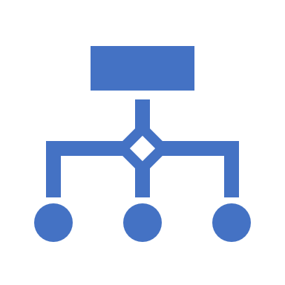
As we can see in the above diagram, the test activities start in parallel with the development activities e.g. during the requirement analysis phase, acceptance-test cases are prepared by the testing team; during the system design phase, the system test case is prepared. Similarly, for each phase of development, a corresponding QA activity is performed. Later, when the deliverable gets ready, the QA artifacts are used to conduct the testing. Along with that, each phase of the development phase is verified before moving to the next phase.

Slide 48
Advantages of V Model
Each phase of development is tested before moving to next phase, hence there is a higher rate of success.
It avoids defect leakage to the later phases as each phase is verified explicitly.
The model has clear and defined steps. So, it is easier to implement.
It is suitable for smaller projects where requirements are fixed.

Slide 49
Disadvantages of V Model
The testing team starts in parallel with development. Hence, the overall budget and resource usage increases.
Change in requirement are difficult to incorporate.
The working model of the software is only available in the later phases of the development.
It is not suitable for complex and large applications because of its rigid process.

Slide 50
Prototype Model
In the case of the prototype model, a working model of the application is created with limited functionality. The prototype is then shown to the customer to get the feedback. This helps in better requirement understanding.

Slide 51
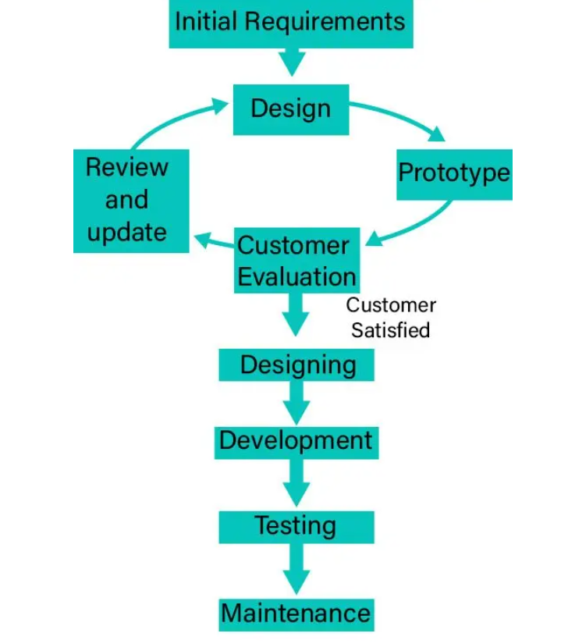

Slide 52
Prototype Model Advantages
Customer satisfaction gets improved as they can see the working software pretty early in the initial phases.
It is easier to figure out any missing requirements and incorporate them.
The developed prototype can also be reused by developers in the project.

Slide 53
Prototype Model Disadvantages
There can be a lack of documentation, since, both the development team as well as the customer rely on the evaluation and feedback of the prototype.
Overall cost and time can increase due to prototype creation and evaluation.
There can be uncertainty in the number of iterations that may be required before the prototype gets finally accepted by the customer.

Slide 54
Iterative Model
In the case of the Iterative model, we start with the implementation of a small set of software requirements to develop the first version of the software. After that, we iteratively implement and incorporate new changes resulting in the creation of new versions of the software until the complete system gets created and deployed.

Slide 55
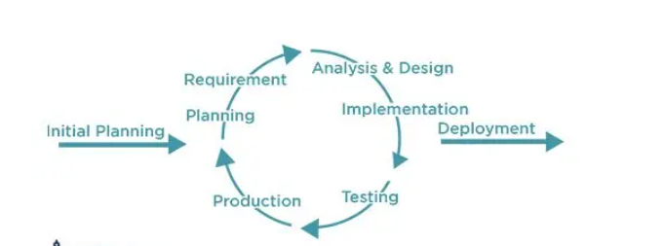

Slide 56
Iterative Model Advantages
Working functionality can be developed very quickly.
It is easier to test and develop due to smaller iterations.
Customer’s feedback can be incorporated easily in the new versions.
Risks can be identified and resolved during iterations.

Slide 57
Iterative Model Disadvantages
Comparatively more resources are required in this model.
It is not advisable to use this model in smaller projects.
Adherence to the project deadline is very difficult because of the multiple versions due to either change in requirements or due incorporation of the client’s feedback.

Slide 58
What is STLC?
Software Testing Life Cycle or STLC refers to a series of systematic and well-defined steps performed during the testing of a software application.
Content
What is STLC?
Advantages of STLC
Phases of STLC
Requirement Analysis
Test Planning and Control
Test Case Development
Test Environment Setup
Test Execution
Test Closure

Slide 59
Advantages of STLC
The testing team gets involved right from the initial phases of SDLC. This helps in a better understanding of the application which results in overall better testing.
It improves the quality of each SDLC phase and also adds to transparency of each process.
STLC ensures lesser project cost and timely delivery since the testing team can uncover bugs and anomalies quickly by following the systematic test process.
Since each STLC phase has a well-defined goal and deliverable so it helps in measuring the progress with the different milestones achieved in each phase.

Slide 60
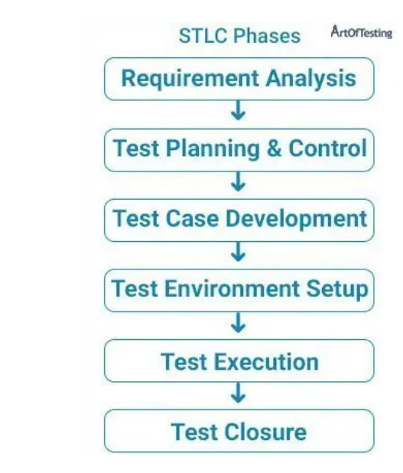
Phases of STLC

Slide 61
SDLC | STLC
Requirements Gathering | Requirement Analysis- The requirements documents are analyzed and validated and the scope of testing is defined.
Designing | Test Planning, Analysis, and Design- Defining test specifications, analysis, and reviewing of requirement documents, risk analysis reports, and other design specifications.
Coding | Test Case Development, Test Environment Setup- Involves the test case creation, test data and environment setup.
Testing | Test Execution- Involves manual and automated test case execution and result logging.
Deployment | Exit Criteria Evaluation, Reporting, and Test Closure- Involves checking if all the project deliverables are delivered, archiving the test ware, test environment, and documenting the learnings.
Maintenance | Maintenance testing- Testing required after an upgrade, correction, or any change in the software under maintenance.

Slide 62
Levels of Testing
Unit Testing
1
Integration Testing
2
System Testing
3
Acceptance Testing
4

Slide 63
Unit Testing
Unit Testing is the first level of testing usually performed by the developers.
In unit testing, a module or component is tested in isolation.
As the testing is limited to a particular module or component, exhaustive testing is possible.
Advantage – Error can be detected at an early stage saving time and money to fix it.
Limitation – Integration issues are not detected in this stage, modules may work perfectly on isolation but can have issues in interfacing between the modules.

Slide 64
Integration Testing
Integration testing is the second level testing performed after unit testing in which we test the interfacing between the modules along with the end to end testing of the integrated components. It can be performed by using both white box and black box testing techniques.

Slide 65
Integration Testing Types
Big-bang Integration
In big bang integration, all the modules are first required to be completed and then integrated. After integration, testing is carried out on the integrated unit as a whole. It is different from system testing as here we focus testing on the interfacing/communication between the modules.
Advantage – It is suitable for smaller projects where we can have all the modules developer before starting with integration testing.
Disadvantage – It is very difficult to incorporate as it is not practical or advisable to have all the modules prepared before starting integration testing.

Slide 66
Top-down Integration Testing
Top-down integration is an incremental approach of integration testing where the testing flow starts from top-level modules (modules higher in the hierarchy) towards the lower-level modules. As there is very much possible that the lower level modules might not have been developed while beginning with top-level modules. So, in those cases, stubs are used. Stubs are dummy modules that simulate the functioning of a module by accepting the parameters received by the module and giving an acceptable result. Generally, stubs have hard-coded input and output that helps in testing the other modules integrated with it.

Slide 67
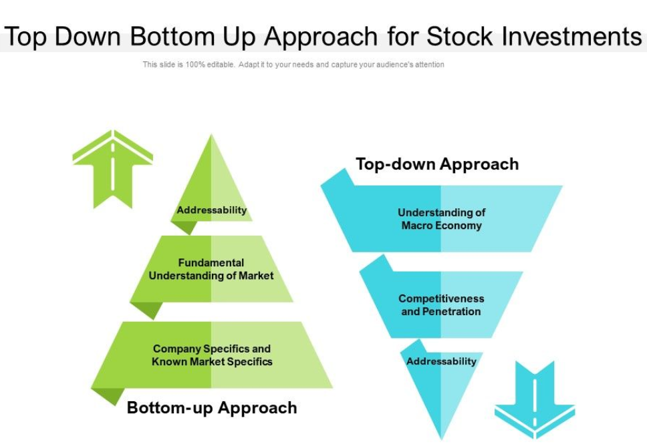

Slide 68
Advantage – We don’t have to wait for all the modules to get developed with the use of stubs. Also, we can prioritize the testing of critical integrated modules first.
Disadvantage – This technique requires the creation of many stubs for the simulating the lower-level modules. Also, the lower-level modules might not get tested adequately.

Slide 69
Bottom-up Integration Testing
Bottom-up integration is also based on an incremental approach and starts from lower-level modules, moving upwards to the higher-level modules. Again the higher-level modules might not have been developed by the time lower modules are tested. So, in those cases, Drivers are used. These drivers simulate the functionality of higher-level modules in order to test lower-level modules.

Slide 70
Advantage – Similar to top-down testing, we don’t have to wait for all the modules to get developed before starting testing.
Disadvantage – The top-level modules that are tested at the later stages, might not get tested adequately and can have bugs.

Slide 71
What is System Testing?
System testing is a type of testing where the application as a whole is tested for its compliance with functional and non-functional requirements. It is carried out by the QA team after the completion of integration testing and before the final acceptance testing. Since in system testing the whole system is tested end to end and the knowledge of coding or internal architecture is not required. Hence, system testing comes under Black-box Testing.

Slide 72
Acceptance Testing
Acceptance testing is the final level of software testing where the system is tested for compliance to its business requirements. It is performed by the client or the end users with the intent to see if the product is fit for delivery. It can be both formal as well as informal.

Slide 73
Types of Acceptance Testing
Alpha Testing
Alpha testing is the form of acceptance testing that takes place at the developer’s site.
It can be carried out by both in-house developers and QAs as well as potential end-users as well.
Alpha testing is not open to the world.
These tests can also be white box along with black-box tests.

Slide 74
Beta Testing
Beta testing is the form of acceptance testing that takes place at the customer’s or the end user’s site.
It is performed after alpha testing and in the real-world environment without the presence or control of developers.
Beta tests or the beta version of the application are normally open to the whole world (or client).
These tests are only black-box.

Slide 75
User Acceptance Testing
User Acceptance Testing – In user acceptance testing, developed application is assessed from the end-users’ perspective, whether it is working for the end-users or not as per the requirements. It is done by employees of the developer organization only. It is also known as ‘End User Testing’ and follows a black box testing mode.

Slide 76
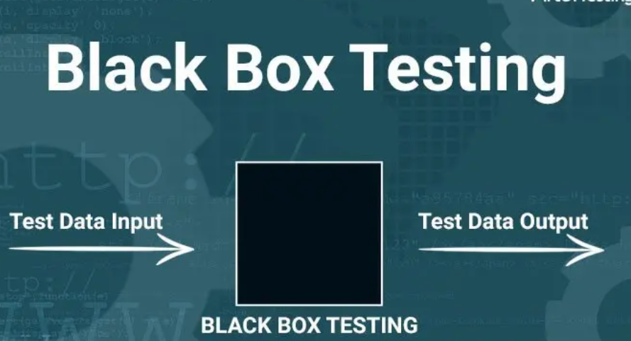
Black Box Testing

Slide 77
Black box testing is the type of testing in which an application is tested based on its requirements specifications without the need for knowledge of its internal architecture.

